Slide 1
Activities of the Lab
in the Array Field
Gruppo di ricerca in “RF, Microwave and Electromagnetics”
Dipartimento di Elettronica e Telecomunicazioni
URL://www.cem.unifi.it
Notes:
Good afternoon, I’m Monica Righini and I’m a member of the reserch group of “RF, Microwave and Electromagnetics” and I’m going to show you the activities of the lab in the array field.

Slide 2
Cosmo Sky-Med
Array Design & Optimization
Fast Phased array analysis
Index
Cosmo Sky-Med
Array Design & Optimization
Fast Phased Array Analysis
Radiating Element;
Beam Forming Network (BFN);
Analytic & Heuristic Array Design;
Optimization of Planar and Linear Arrays;
Notes:
I’m going to start with the COSMO Sky-Med project and than my colleauges show you the array design & optimization and the fast phased array analysis.

Slide 3
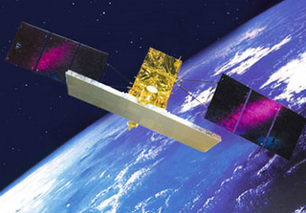
Cosmo Sky-Med
Array Design & Optimization
Fast Pased array analysis
Introduction
Cosmo-SkyMed is the first Earth system observation designed for both civil and military use. This system has been developed by ASI (Agenzia Spaziale Italiana) in collaboration with Ministero Italiano della Difesa (Italian Defense Ministery).
Notes:
The Cosmo Sky Med is the first Earth system observation designed for both civil and military use. This system has been devolped by ASI in collabortion with Italian Defense Ministery.
This system is composed by four satellites each of them have a Syntethic aperture radar operating in X-band.
Currently the first system is already operating, in order to improve the bandwidth of system and the efficiency ASI has already started the development of the second generation system by commissioning the radiating system project to Thales Alenia Space company.

Slide 4
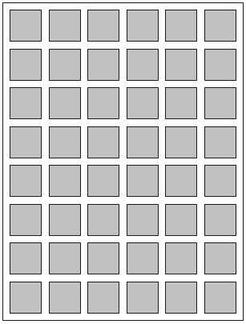
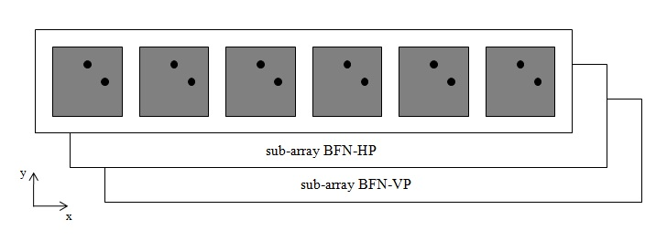
Cosmo Sky-Med
Array Design & Optimization
Fast Pased array analysis
Introduction
The radiating board works at the central frequency of 9.6 GHz over a bandwidth of 16% and it’s composed by 48 radiating elements subdivided in 8 sub-array.
radiating element
sub-array
VP
HP
Notes:
The architecture of radiating system is quite similar to the first generation system and it is composed by several radiating boards, which work at the central frequency of 9.6 GHz over a bandwidth of 16%. Each radiating board is composed by 8 sub-array and each sub-array is composed by six dual-polarized elements. As you can see in figure of right each sub-array needs of two Beam forming network one for each polarization. These Beam forming network are the first level of feeding, the second level of feeding feeds the 8 sub-array with variation of phase.

Slide 5
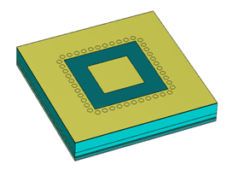
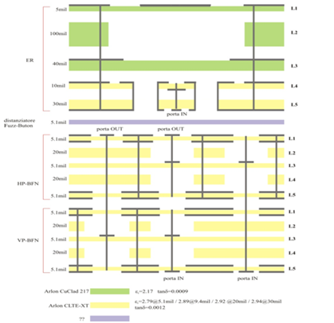
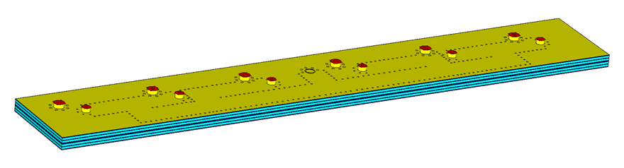
Cosmo Sky-Med
Array Design & Optimization
Fast Pased array analysis
Introduction
Notes:
Here you can see the stratification of one radiating element with its feeding network of first level. As you can see the whole structure is composed by 16 layers. Now I show you in detail both radiating element and beam forming network of first level.

Slide 6
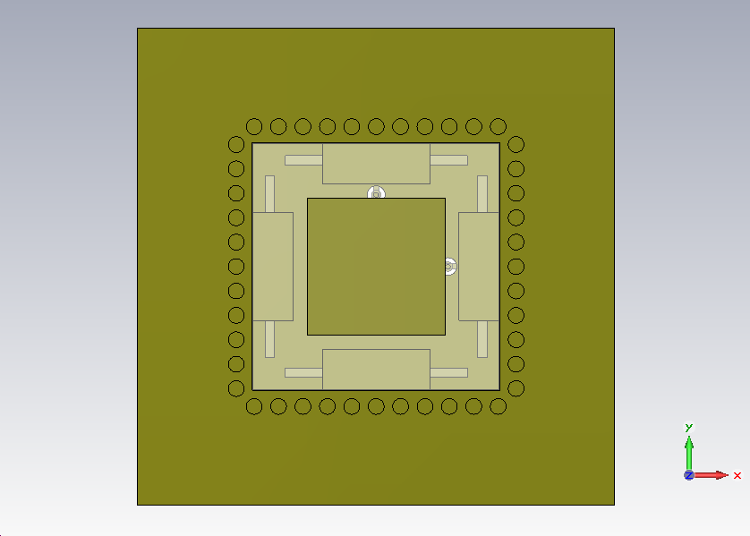
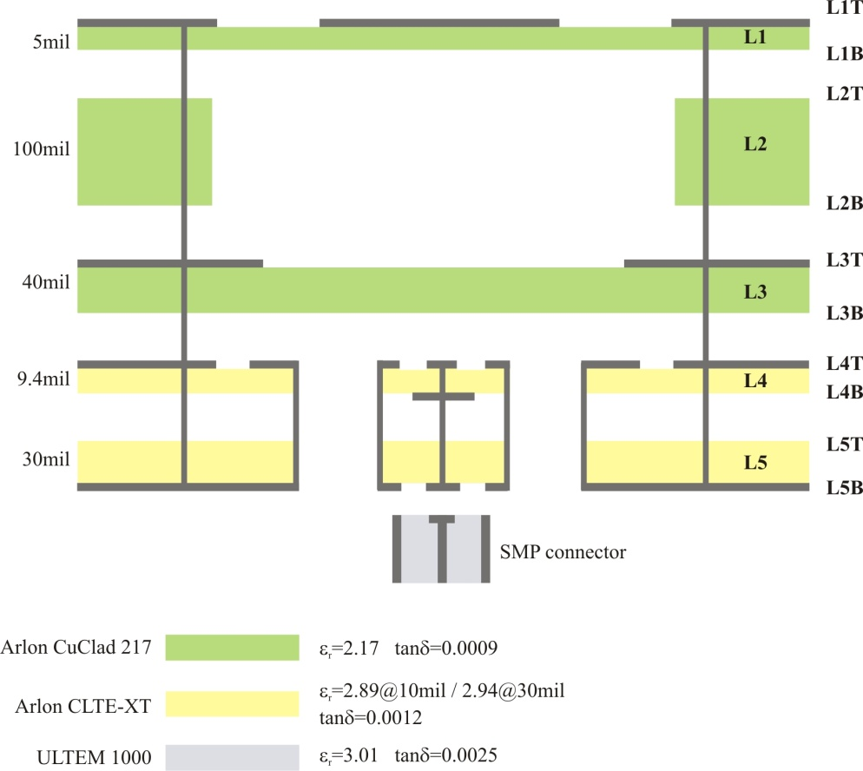
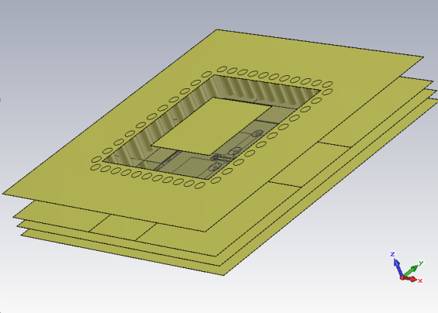
Cosmo Sky-Med
Array Design & Optimization
Fast Pased array analysis
Radiating Element
Notes:
The radiating element is a dual-polarization multilayer patch antenna composed by 5 layers. The first three layers represent the radiating part of the element. The 4 patchs of the third layer are fed by 4 slots situated in the forth layer. The 4 patchs are in a cavity which is formed by several via-holes. These via-holes go through the whole structure and isolate each single element. At the first layer there is an anular slot which is the exit point of radiation.

Slide 7
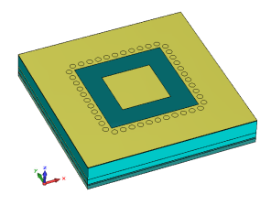
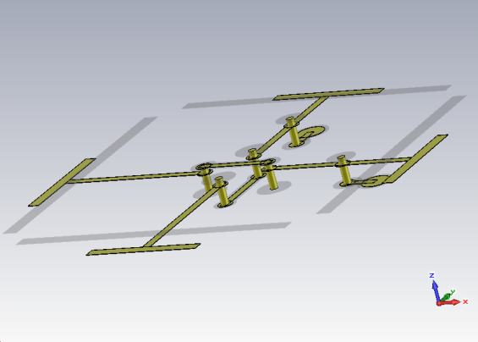
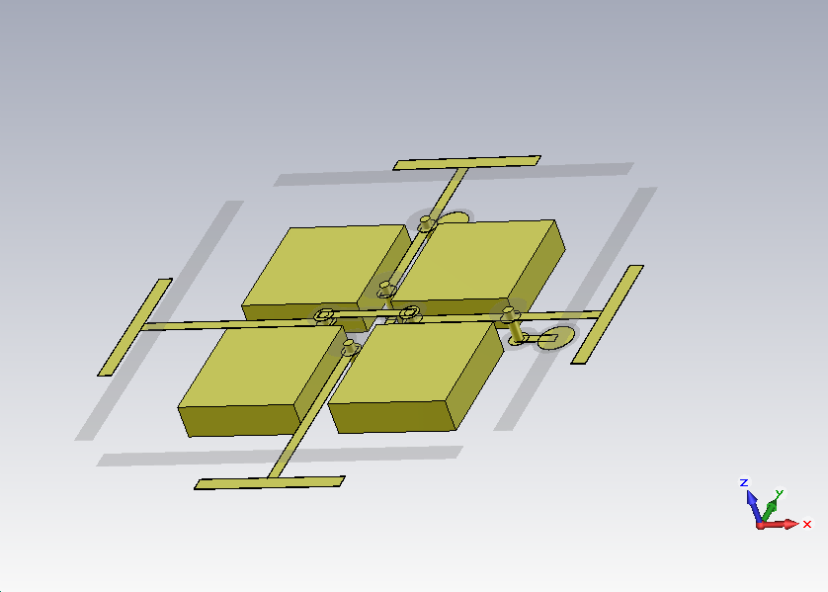
Cosmo Sky-Med
Array Design & Optimization
Fast Pased array analysis
Radiating Element
VP
HP
Notes:
The 4th and 5th layers contain the feeding network of the single element.
This feeding network is composed by 4 offset strip-lines in a cross configuration (two for each polarization) that end on 4 stubs.
To avoid electrical contact between the two lines, on each it was added a bridge in coplanar waveguide. For horizontal polarization the bridge is on the ground plane at the 4th layer, while for vertical polarization the bridge is on the ground plane at the 5th layer.
This choice has two positive aspects: it allows to maximise isolation between the two lines and to minimise the number of layers. To improve the isolation 4 cubes has been installed that protect each single line.
This feeding network is connected to the beam forming network of first level by a two via-hole. To check the performance of the radiating element it has been decided to feed it with two coaxial connectors at 50 Ohm. Let me show you the results of this simulation.

Slide 8
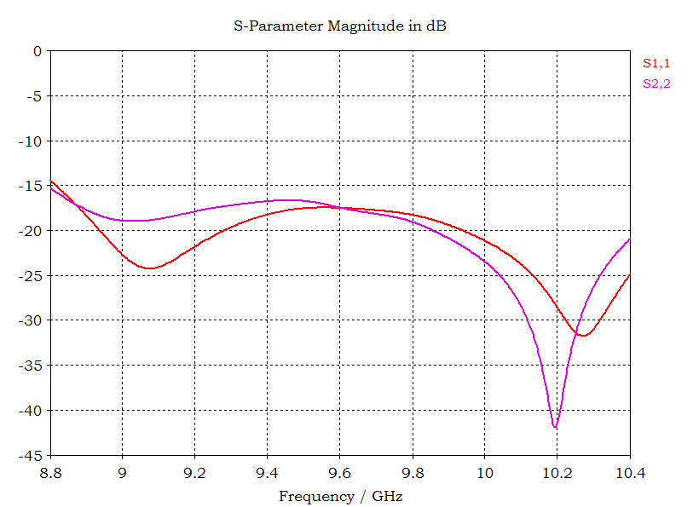
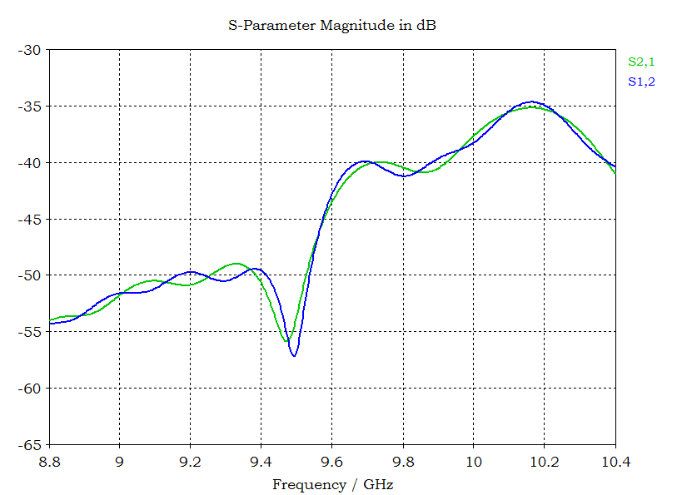
Cosmo Sky-Med
Array Design & Optimization
Fast Pased array analysis
Radiating Element
Return loss H/V ports
Isolation H/V ports
The return loss is better than 14 dB over the whole bandwidth for both ports.
The isolation is better than 30 dB over the whole bandwidth for both ports.
Notes:
Here you can see the return loss and the isolation between the two ports over the whole bandwidth. As you can see the return loss is better than 14 dB over the whole bandwidth and the isolation is better than 30 dB.

Slide 9
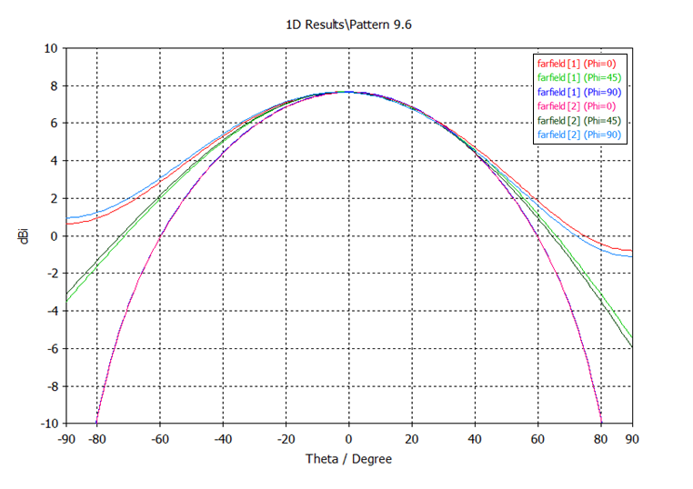
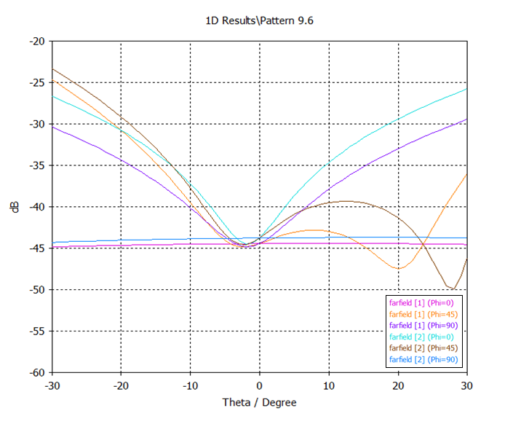
Cosmo Sky-Med
Array Design & Optimization
Fast Pased array analysis
Radiating Element
Co-polar components H/V ports
Cross-polar components H/V ports
The radiating element have a maximum at 0° with a dirctivity about 7.8 dBi
Over an angle of 30° the cross-polar component is better than -23 dB.
Notes:
Here there are a co-polar and cross-polar components at the central frequency of 9.6 GHz for both ports and for three angles of phi 0, 45 and 90 degree. As you can see the maximum directivity is about 7.8 dBi and the cross-polar component is better than -23 dB over an angle of 30 degree.

Slide 10

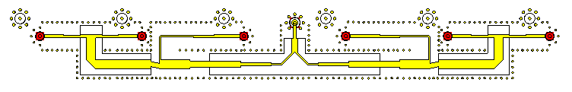
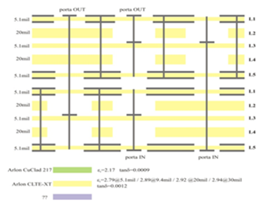
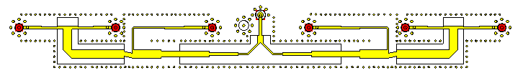
Cosmo Sky-Med
Array Design & Optimization
Fast Pased array analysis
BFN
horizontal BFN
vertical BFN
Notes:
As already said the radiating board is formed by 8 sub-array, each of them is composed by 6 radiating elements like that described above. Each sub-array is fed (feeded) by two beam forming network (one for each polarization) placed one on the other and traslated. To connect the output ports to the input ports of radiating elements 12 via-holes have been used (6 via-holes of the vertical BFN cross the horizontal BFN and the remaining 6 via-holes are integrated in the horizontal BFN).
In figures at the right you can see the schematichs of lines. As you can see these lines are very similar, the differences are due to via-holes that connect the first level BFN to the second level BFN and the first level BFN to the radiating element. These are minimal differences that have no influence on the BFN performance and for this reason one simulation has been sufficient for the validity of results.
To check the performance of the radiating element it has been decided to feed it with two coaxial connectors at 50 Ohm. Let me show you the results of this simulation.

Slide 11
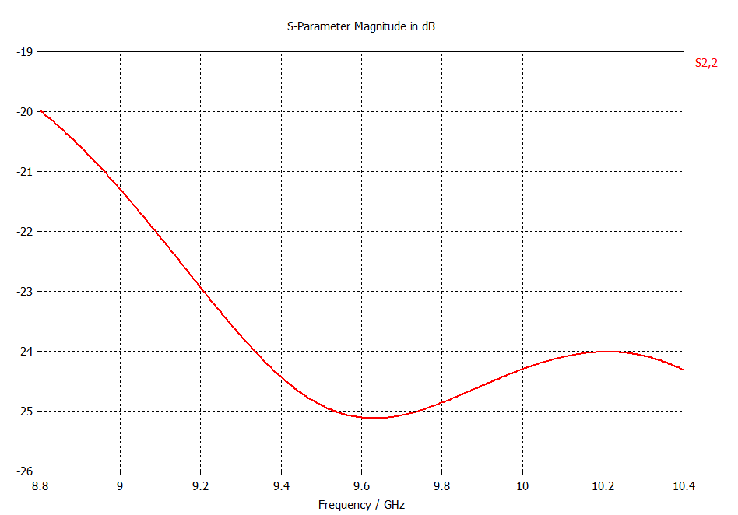
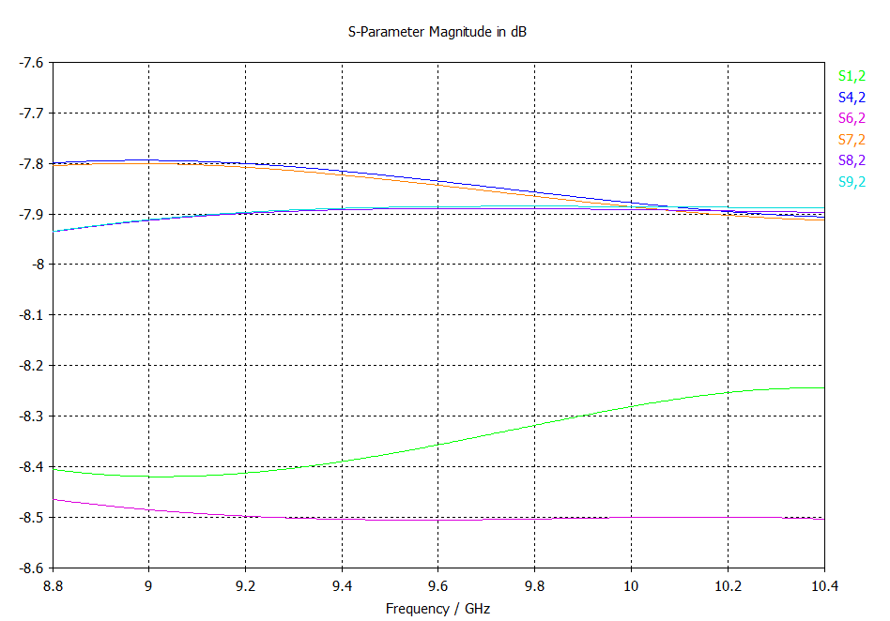
Cosmo Sky-Med
Array Design & Optimization
Fast Pased array analysis
BFN
Return loss H/V ports
Transmission H/V ports
The return loss is better than 20 dB over the whole bandwidth.
The maximum deviation in bandwidth is about 0.7 dB.
Notes:
Here you can see the return loss and the transmission parameters over the whole bandwidth. As you can see the return loss is better than 20 dB over the whole bandwidth and the maximum deviation in bandwidth for the transmission parameters is about 0.7 dB.

Slide 12
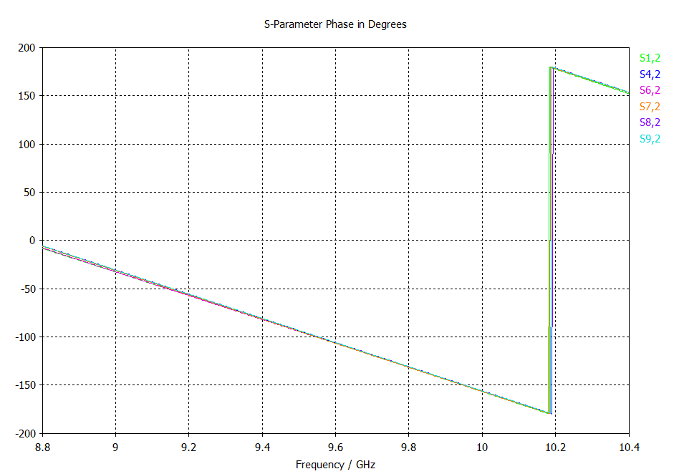
Cosmo Sky-Med
Array Design & Optimization
Fast Pased array analysis
BFN
Phase H/V ports
All ports are in phase.
Notes:
As you can see the six ports are perfectly in phase. Currently the radiating element and the first level BFN are under construction and the results showed in this simulation will be compared with the effective measures/measurements.
I thank you for the attention and now I introduce you Mr Setfano Selleri.

Slide 13
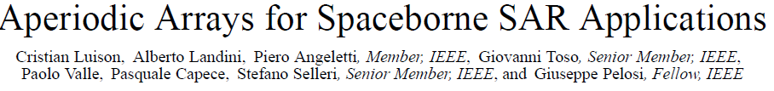
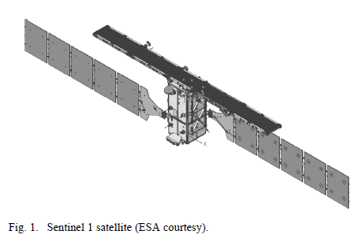
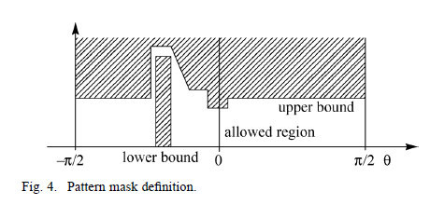
Cosmo Sky-Med
Array Design & Optimization
Fast Phased array analysis
Analytic & Heuristic Array Design
Design of a large planar array to comply to specific SAR masks

Slide 14
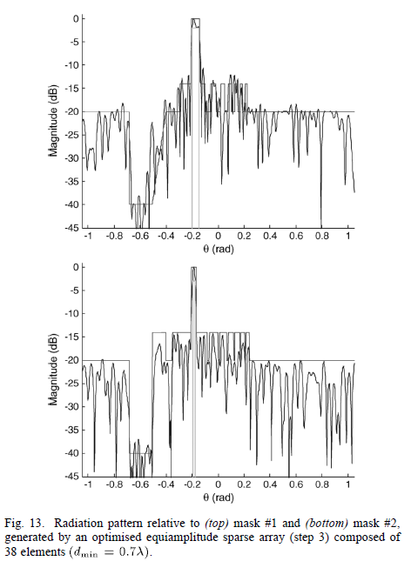
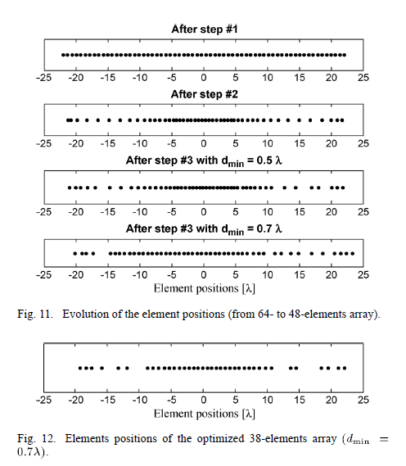
Cosmo Sky-Med
Array Design & Optimization
Fast Phased array analysis
Analytic & Heuristic Array Design

Slide 15

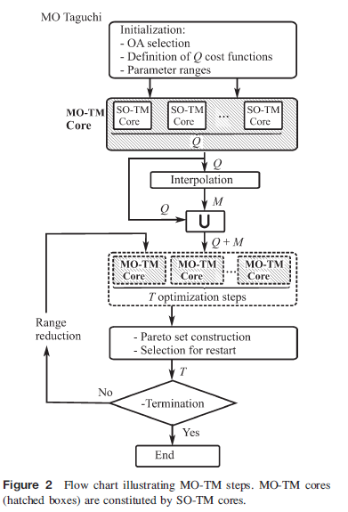
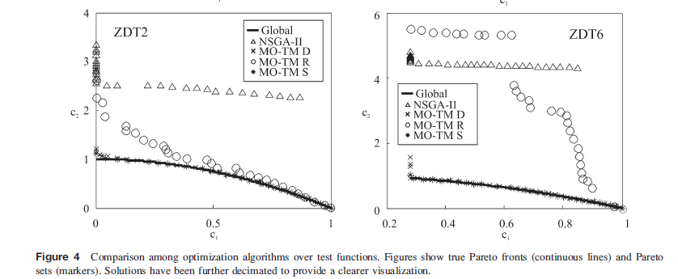
Cosmo Sky-Med
Array Design & Optimization
Fast Phased array analysis
Optimization of Planar and Linear Arrays
Development of new Multi-Objective techniques

Slide 16
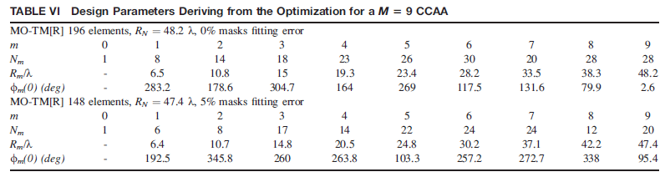
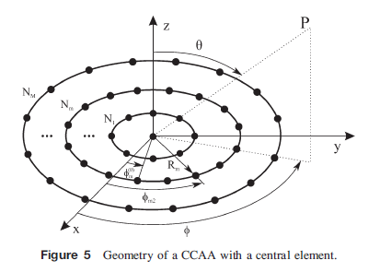
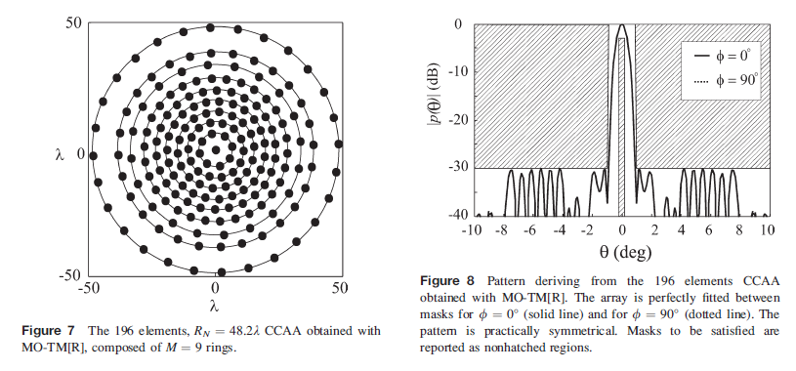
Cosmo Sky-Med
Array Design & Optimization
Fast Phased array analysis
Optimization of Planar and Linear Arrays

Slide 17
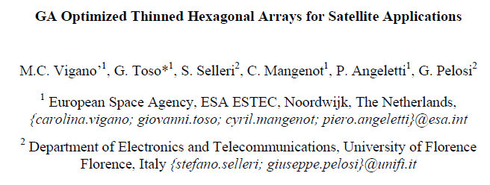
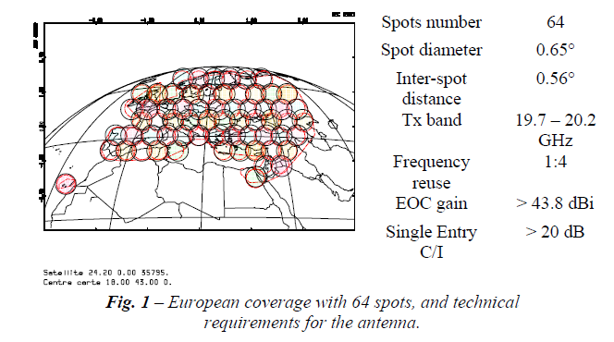
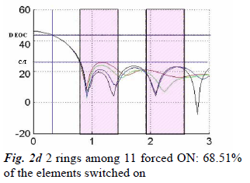
Cosmo Sky-Med
Array Design & Optimization
Fast Phased array analysis
Optimization of Planar and Linear Arrays
Multibeam thinned arrays
(APS 2007)

Slide 18
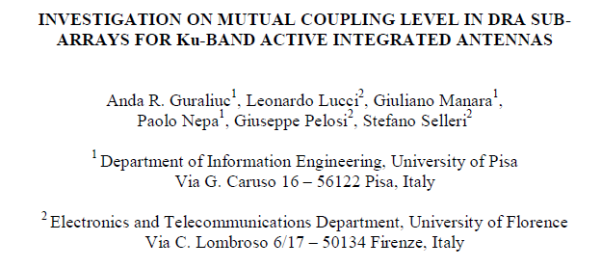
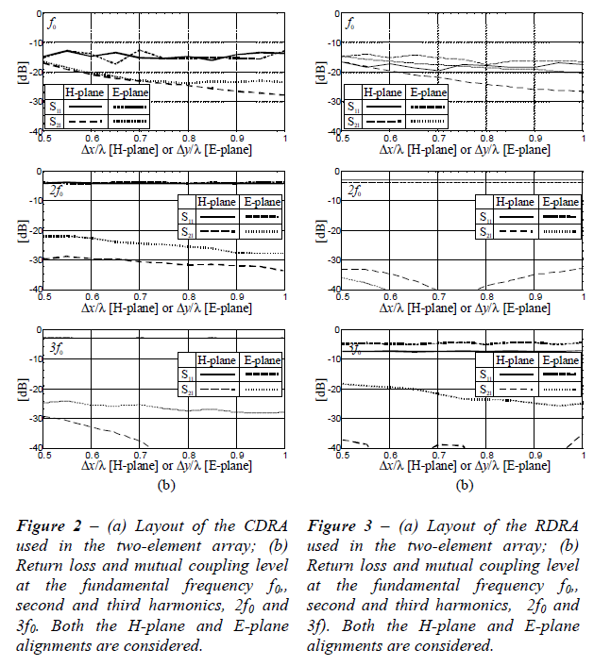
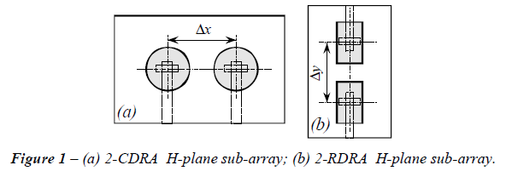
Cosmo Sky-Med
Array Design & Optimization
Fast Phased array analysis
Optimization of Planar and Linear Arrays
Element coupling
(APS 2008)

Slide 19
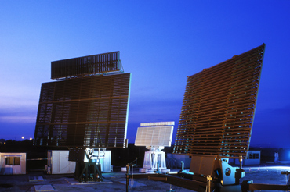

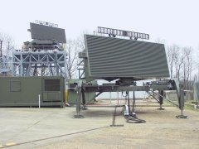
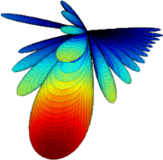
Cosmo Sky-Med
Array Design & Optimization
Fast phased array pattern computation
Introduction
Need for fast and accurate prediction of large phased array antennas pattern in front of a beamsteering process:
Finite elements (FE) with geometric multigrid preconditioned iterative solvers are employed for near field computations (including antennas coupling, dielectric losses, etc.)
Near field to far field transformation (N2F): Stratton-Chu formulas for pattern computation using a Fourier approximation (FFT)
A projection-based model order reduction (MOR) allows for significant pattern computations speedup

Slide 20
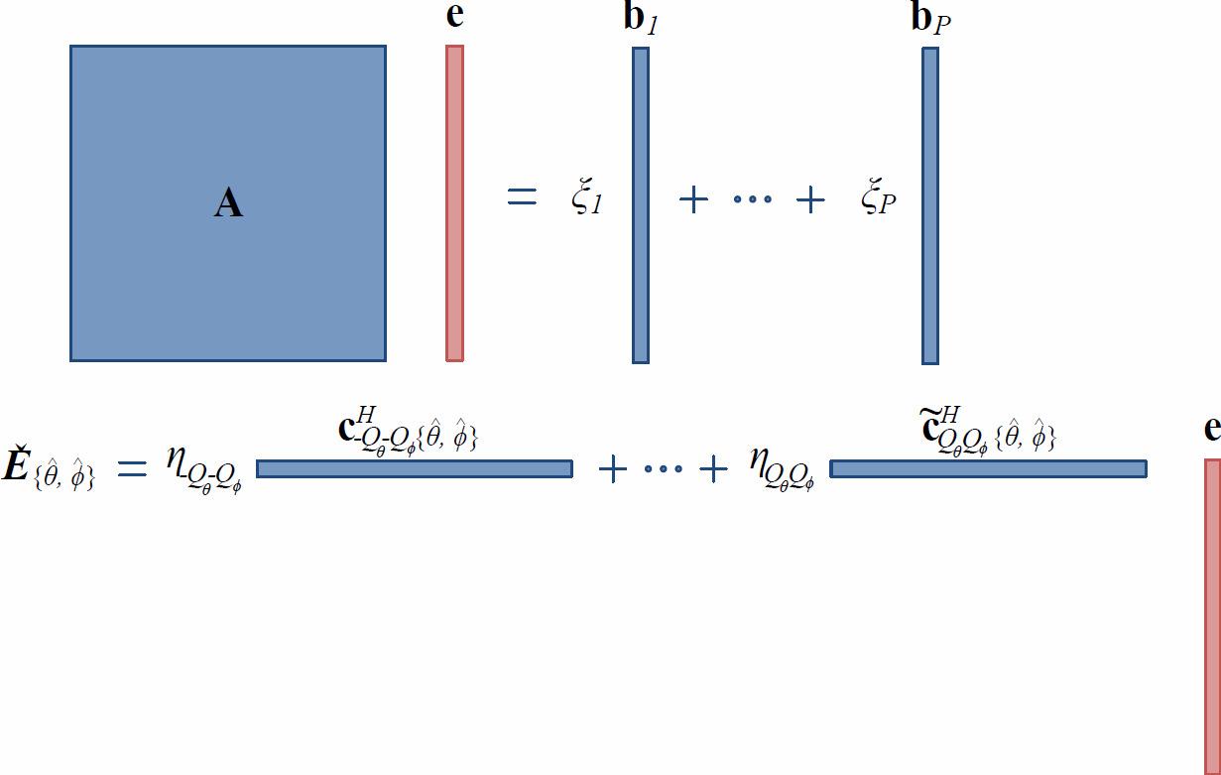
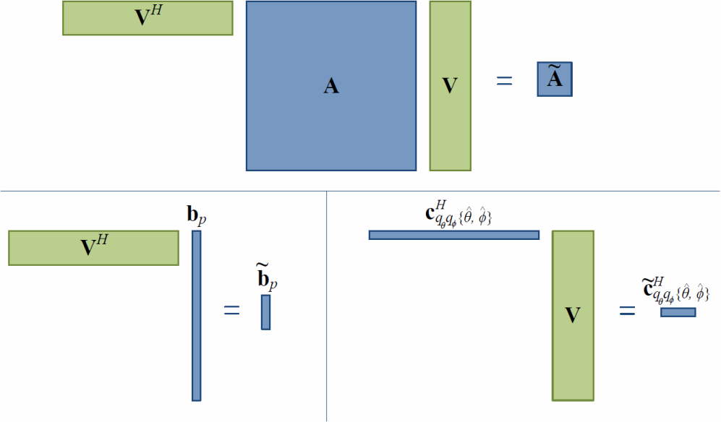
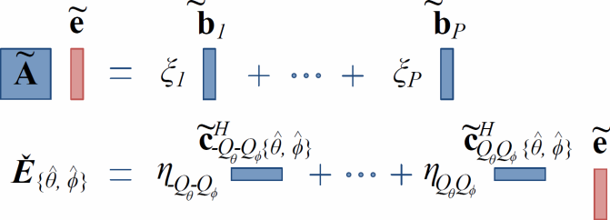
Cosmo Sky-Med
Array Design & Optimization
Fast phased array pattern computation
Radiation model
Full radiation system
Projection-based MOR: V is a collection of P linearly independent solutions for different scan angles (θ_{s},ϕ_{s})
Complex weighting at ports excitations
FE
N2F
Reduced order radiation system
S-parameters retrievable from V e͂

Slide 21
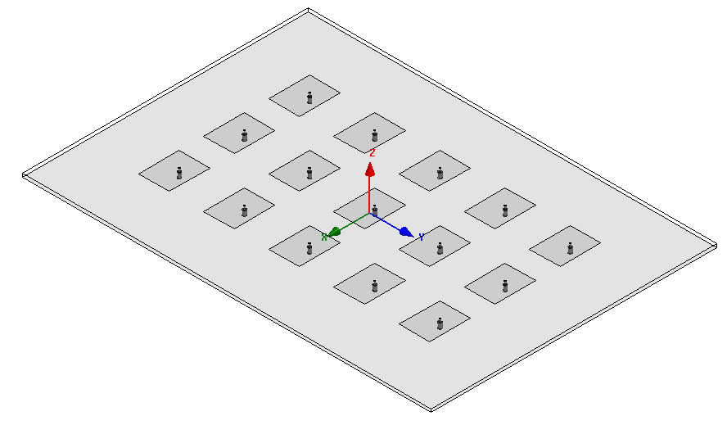
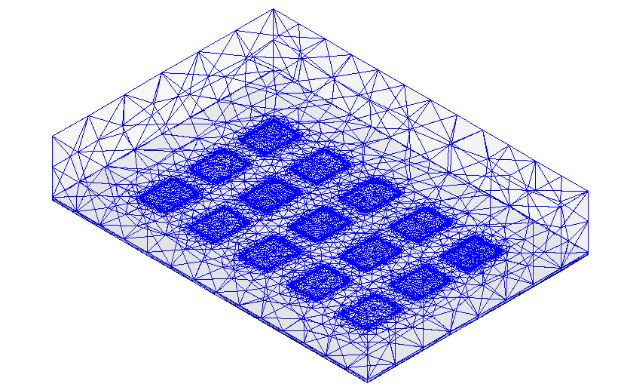
Cosmo Sky-Med
Array Design & Optimization
Fast phased array pattern computation
Numerical results
3x5 coaxial-fed rectangular patch antennas array:
Working frequency: 2.35 GHz
Vector Helmholtz equation for the electric field with 1st order edge basis functions:
Mesh tetrahedra: 292’410
Full radiation model rank: 358’648

Slide 22
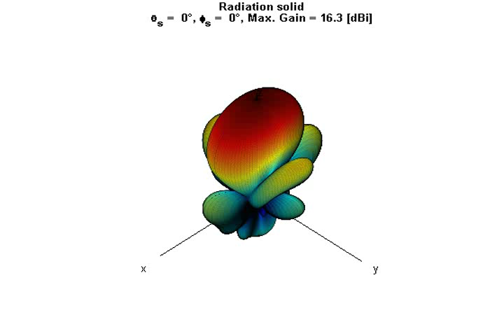
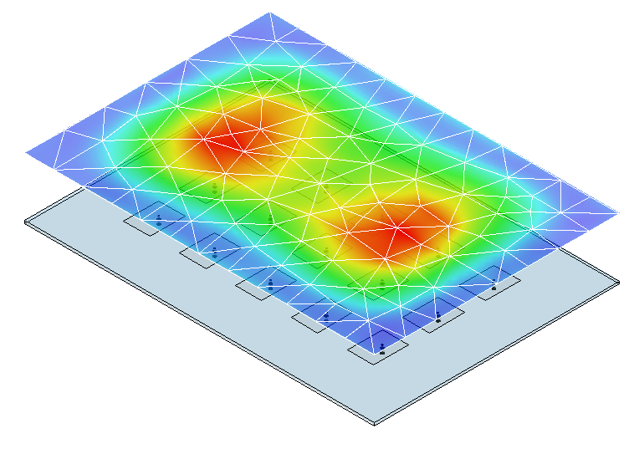
Cosmo Sky-Med
Array Design & Optimization
Fast phased array pattern computation
Numerical results
Rank(V) = 15 (n° of antennas)
n° of DoFs: 358’648 → 15
Memory usage: 625 MB → 1.5 MB
MOR error: ε ≤ 10⁻¹¹
2D-DFT truncation error: ε_{n2f} ≤ 10⁻⁴
≈ 0.01 dB max. gain error
Whole movie:
for HFSS (commercial package) 10 h 20 min
for the full parameterized model: 1 min 3 s
for the reduced parameterized model: 8 s

